Slide 1
Neighborhoods Effects and Intergenerational Mobility
in the United States
Raj Chetty
Based on joint work with
Nathaniel Hendren, Emmanuel Saez, Patrick Kline, Lawrence Katz, Alex Bell, Xavier Jaravel, Neviana Petkova, and John van Reenen
The opinions expressed in this paper are those of the authors alone and do not necessarily reflect the views of the Internal Revenue Service or the U.S. Treasury Department.

Slide 2
The American Dream?
Probability that a child born to parents in the bottom fifth of the income distribution reaches the top fifth:

Slide 3
The American Dream?
Probability that a child born to parents in the bottom fifth of the income distribution reaches the top fifth:
USA
Chetty, Hendren, Kline, Saez 2014
7.5%
UK
Blanden and Machin 2008
9.0%
Denmark
Boserup, Kopczuk, and Kreiner 2013
11.7%
Canada
Corak and Heisz 1999
13.5%

Slide 4
The American Dream?
Probability that a child born to parents in the bottom fifth of the income distribution reaches the top fifth:
→ Chances of achieving the “American Dream” are almost
two times higher in Canada than in the U.S.
USA
Chetty, Hendren, Kline, Saez 2014
7.5%
UK
Blanden and Machin 2008
9.0%
Denmark
Boserup, Kopczuk, and Kreiner 2013
11.7%
Canada
Corak and Heisz 1999
13.5%

Slide 5
Differences in Intergenerational Mobility Within the U.S.
Differences across countries have attracted attention
But upward mobility varies even more within the U.S.
We calculate upward mobility for every metro and rural area in the U.S.
  Use tax records on 10 million children born between 1980-1982
  Measure children’s income when they are 30 years old
  Rank children and parents in national income distribution and assign children to locations based on where they grew up
Source: Chetty, Hendren, Kline, Saez 2014

Slide 6
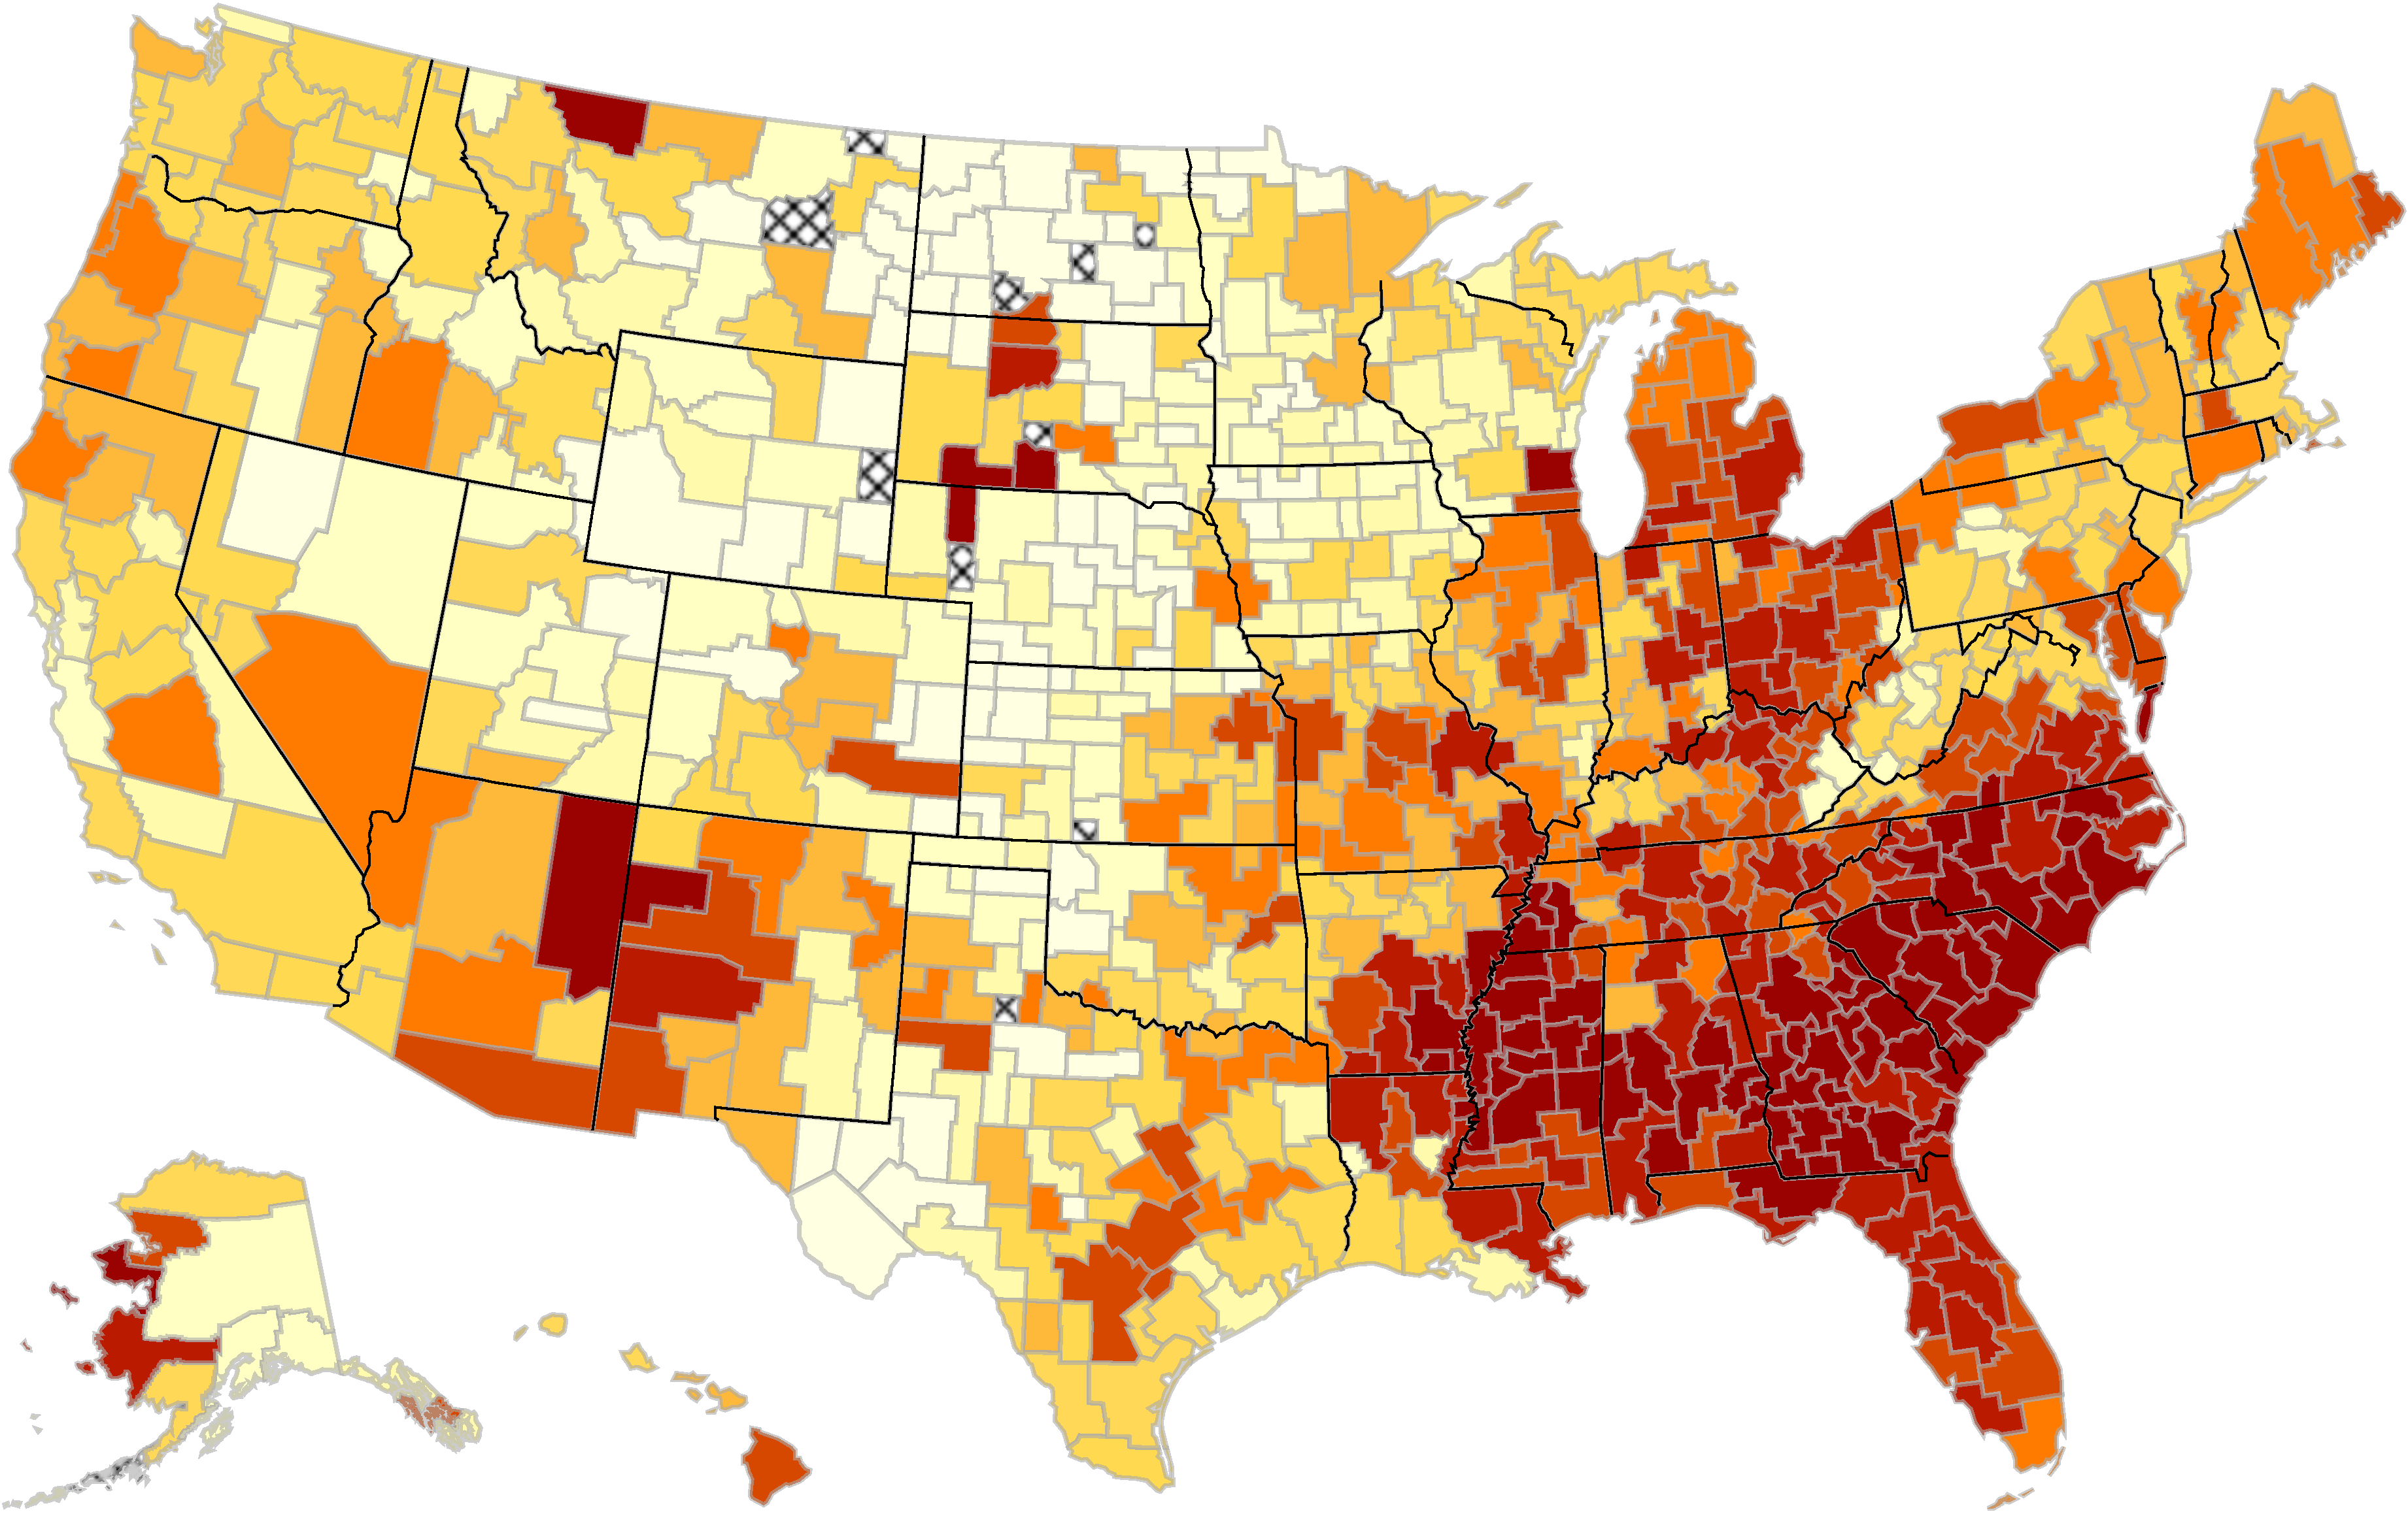
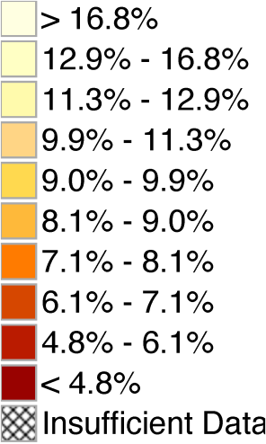
The Geography of Upward Mobility in the United States
Chances of Reaching the Top Fifth Starting from the Bottom Fifth by Metro Area
Denver 8.7%
Minneapolis 8.5%
Chicago
6.5%
Boston 10.4%
San
Jose
12.9%
Washington DC 11.0%
Charlotte 4.4%
Salt Lake City 10.8%
Atlanta 4.5%
New Orleans 5.1%
Note: Lighter Color = More Upward Mobility
Download Statistics for Your Area at www.equality-of-opportunity.org

Slide 7
Mean Child Income Rank vs. Parent Income Rank
for Children Born in 1985 and Raised in Chicago
70
60
50
Mean Child Rank in National Income Distribution
40
30
20
0
10
20
30
40
50
60
70
80
90
100
Parent Rank in National Income Distribution

Slide 8
Mean Child Income Rank vs. Parent Income Rank
for Children Born in 1985 and Raised in Chicago
70
60
50
Mean Child Rank in National Income Distribution
40
30
Focus on mean income rank for children with parents at 25th percentile based on linear prediction
20
0
10
20
30
40
50
60
70
80
90
100
Parent Rank in National Income Distribution

Slide 9
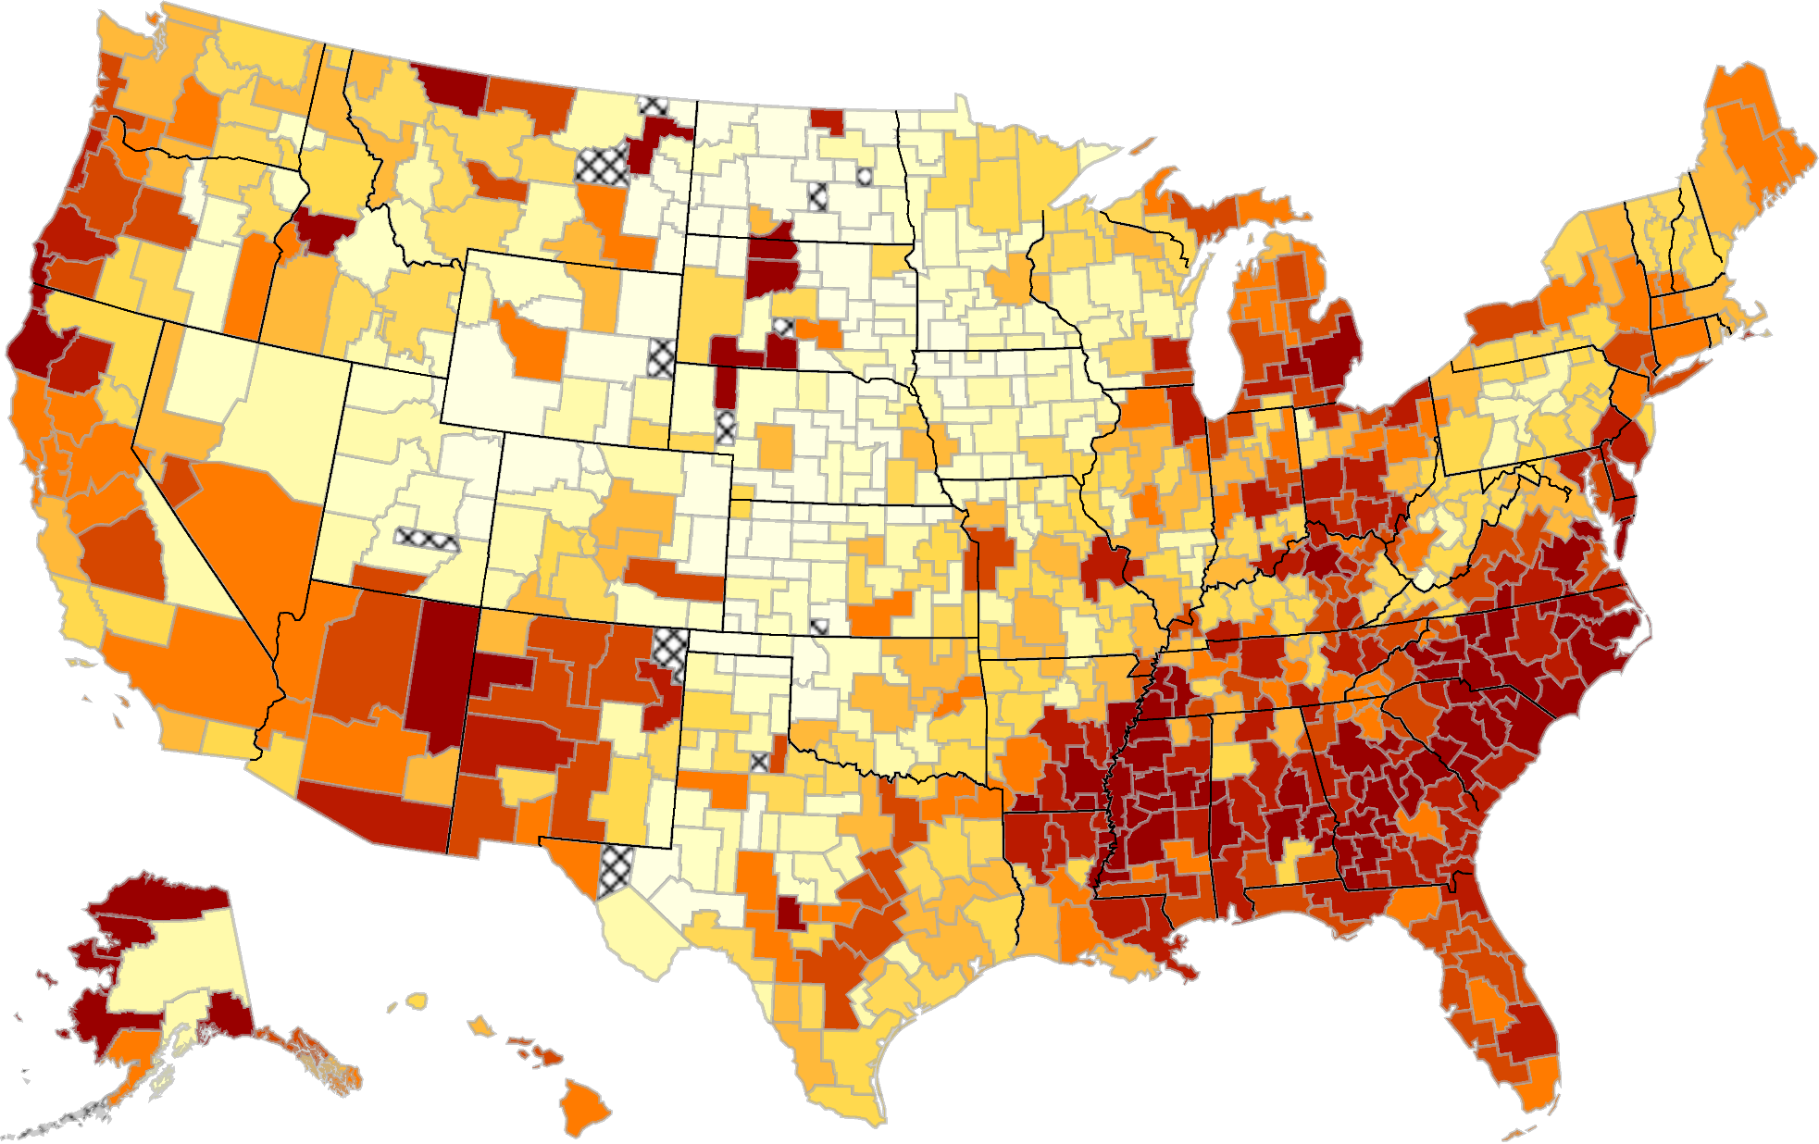
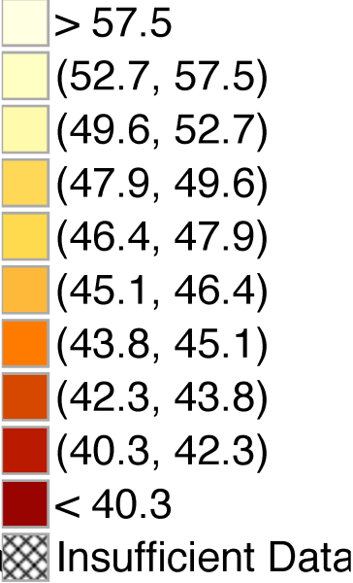
The Geography of Intergenerational Mobility in the United States
Mean Income Rank at Age 26 for Children with Parents at 25th Percentile

Slide 10
Why Does Intergenerational Mobility Vary Across Places?
Two very different explanations for variation in children’s outcomes across areas:
  Selection: different people live in different places
  Neighborhood effects: places have a causal effect on upward mobility for a given person
Longstanding debate in sociology and economics about these competing hypotheses [e.g., Wilson 1987, Massey and Denton 1993, Cutler and Glaeser 1997, Katz et al. 2001, Altonji and Mansfield 2014]

Slide 11
Identifying Causal Effects of Place Using Movers
We identify causal effects of neighborhoods by studying 5 million families who move across areas in tax data
  Key idea: exploit variation in age of child when family moves to identify causal effects
Regress mover’s income rank at age 26 on expected rank of permanent residents in destination:
  Include parent decile by origin by birth cohort fixed effects so identification comes from variation in destinations
Source: Chetty and Hendren 2015

Slide 12
Movers’ Outcomes vs. Predicted Outcomes Based on Residents in Destination
Children Age 13 at Time of Move
4
2
0
Mean (Residual) Child Rank in National Income Distribution
Slope: 0.628
(0.048)
-2
-4
-6
-4
-2
0
2
4
6
Predicted Diff. in Child Rank Based on Permanent Residents in Dest. vs. Orig.
at Same Parent Income Percentile

Slide 13
Movers’ Outcomes vs. Predicted Outcomes Based on Residents in Destination
By Child’s Age at Move
0.8
0.6
b_{m} > 0 for m > 26: Selection Effect
Coefficient on Predicted Rank in Destination
0.4
0.2
10
15
20
25
30
Age of Child when Parents Move

Slide 14
Movers’ Outcomes vs. Predicted Outcomes Based on Residents in Destination
By Child’s Age at Move
0.8
0.6
b_{m} > 0 for m > 26: Selection Effect
Coefficient on Predicted Rank in Destination
0.4
b_{m} declining with m Exposure Effects
0.2
10
15
20
25
30
Age of Child when Parents Move

Slide 15
Movers’ Outcomes vs. Predicted Outcomes Based on Residents in Destination
By Child’s Age at Move
0.8
0.6
δ: 0.226
Coefficient on Predicted Rank in Destination
Slope: -0.038
Slope: -0.002
(0.002)
(0.011)
0.4
0.2
Ident. Assumption: Selection does not vary with age
at move → slope of 3.8% is causal exposure effect
10
15
20
25
30
Age of Child when Parents Move

Slide 16
Family Fixed Effects: Sibling Comparisons
0.8
0.6
0.4
Coefficient on Predicted Rank in Destination (b_{m})
δ (Age > 23): 0.008
Slope (Age ≤ 23): -0.043
Slope (Age > 23): -0.003
(0.003)
(0.013)
0.2
0
10
15
20
25
30
Age of Child when Parents Move (m)

Slide 17
Family Fixed Effects: Sibling Comparisons
with Controls for Change in Income and Marital Status at Move
0.8
0.6
Coefficient on Predicted Rank in Destination (b_{m})
0.4
δ (Age > 23): 0.015
Slope (Age ≤ 23): -0.042
Slope (Age > 23): -0.003
(0.003)
(0.013)
0.2
0
10
15
20
25
30
Age of Child when Parents Move (m)

Slide 18
Identifying Causal Effects: Time-Varying Unobservables
Evaluate confounds due to unobservable shocks (e.g., changes in wealth) using two approaches
  Experimental variation: Moving to Opportunity experiment
  Outcome-based placebo (overidentification) tests

Slide 19
Identifying Causal Effects: Outcome-Based Placebo Tests
General idea: exploit heterogeneity across subgroups to construct overidentification tests
For example, exposure model predicts convergence to permanent residents’ outcomes not just on means but across entire distribution
  Variance of earnings for children of permanent residents in SF is higher than for children of permanent residents in Boston
  Exposure model predicts that children who move to SF at younger ages should be more likely to end up in tails
Less likely that unobserved shock would replicate full distribution of outcomes in destination area in proportion to exposure time

Slide 20
Exposure Effects on Upper-Tail and Lower-Tail Outcomes
Comparisons of Impacts at P90 and Non-Employment
 | Dependent Variable
 | Child Rank in top 10% |  |  |  |  |  | Child Employed
 | (1) | (2) |  | (3) |  |  | (4) | (5) | (6)
Distributional Prediction | 0.043 |  |  | 0.040 |  |  | 0.046 |  | 0.045
 | (0.002) |  |  | (0.003) |  |  | (0.003) |  | (0.004)
Mean Rank Prediction |  | 0.022 |  | 0.004 |  |  |  | 0.021 | 0.000
(Placebo) |  | (0.002) |  | (0.003) |  |  |  | (0.002) | (0.003)

Slide 21
Identifying Causal Effects: Outcome-Based Placebo Tests
We find similar convergence to outcomes of residents in destination by gender and birth cohort
  Moving to a place where boys have especially high earnings → son improves in proportion to exposure but daughter does not
Conclude that timing-of-move design yields unbiased estimates of neighborhoods’ causal exposure effects

Slide 22
County-Level Predictions of Causal Effects
Use exposure time design to identify causal effect of each county on earnings by estimating a fixed effects model on 5 million movers
  Intuition: children who move from Manhattan to Queens at younger ages earn more as adults
  Can infer that Manhattan has a positive effect relative to Queens
Estimate fixed effects of all counties, identifying purely from differences in timing of moves across areas
  Construct MSE-minimizing forecasts of each place’s causal effect using a shrinkage estimator (see paper for details)
  Scale estimates as pct. change in earnings per year of exposure

Slide 23
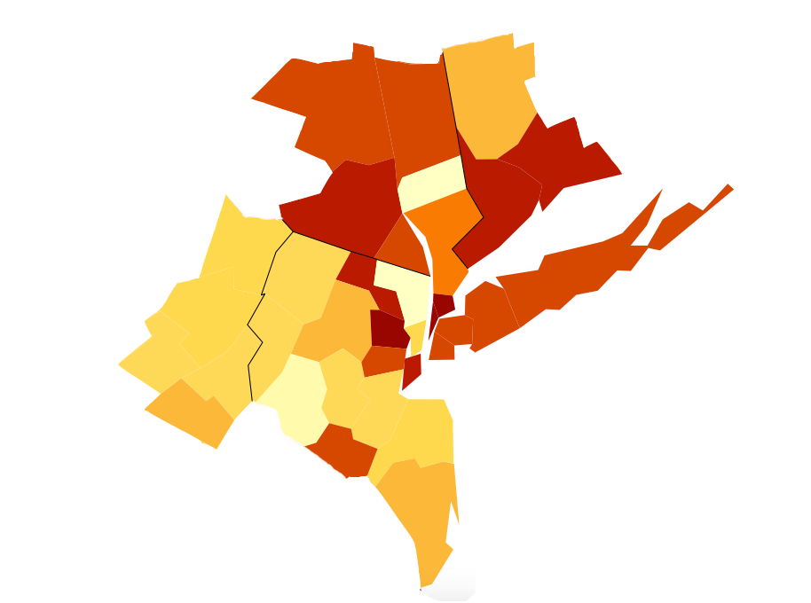
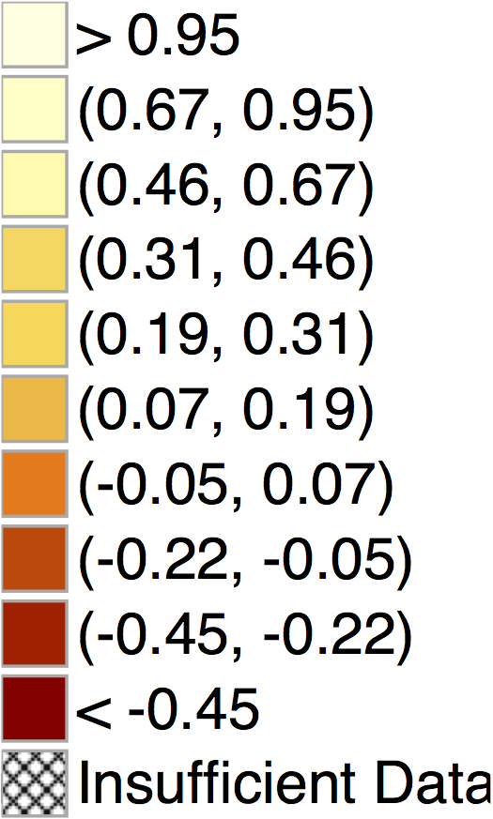
Exposure Effects on Income in the New York CSA
For Children with Parents at 25th Percentile of Income Distribution
Ulster
New Haven
Bergen
Suffolk
Bronx
Monroe
Queens
Brooklyn
Hudson
Ocean
Causal Exposure Effects Per Year:
Bronx NY: -0.54%
Bergen NJ: +0.69%

Slide 24
Annual Exposure Effects on Income for Children in Low-Income Families (p25)
Top 10 and Bottom 10 Among the 100 Largest Counties in the U.S.
Top 10 Counties |  |  |  |  |  | Bottom 10 Counties
Rank | County |  | Annual Exposure Effect (%) |  |  | Rank | County | Annual Exposure Effect (%)
1 | Dupage, IL |  | 0.76 |  |  | 91 | Pima, AZ | -0.61
2 | Snohomish, WA |  | 0.72 |  |  | 92 | Bronx, NY | -0.62
3 | Bergen, NJ |  | 0.71 |  |  | 93 | Milwaukee, WI | -0.62
4 | Bucks, PA |  | 0.66 |  |  | 94 | Wayne, MI | -0.63
5 | Contra Costa, CA |  | 0.61 |  |  | 95 | Fresno, CA | -0.65
6 | Fairfax, VA |  | 0.60 |  |  | 96 | Cook, IL | -0.67
7 | King, WA |  | 0.57 |  |  | 97 | Orange, FL | -0.67
8 | Norfolk, MA |  | 0.54 |  |  | 98 | Hillsborough, FL | -0.67
9 | Montgomery, MD |  | 0.52 |  |  | 99 | Mecklenburg, NC | -0.69
10 | Middlesex, NJ |  | 0.43 |  |  | 100 | Baltimore City, MD | -0.86
Exposure effects represent % change in adult earnings per year of childhood spent in county

Slide 25
Annual Exposure Effects on Income for Children in Low-Income Families (p25)
Male Children
Top 10 Counties |  |  |  | Bottom 10 Counties
Rank | County | Annual Exposure Effect (%) |  | Rank | County | Annual Exposure Effect (%)
1 | Bucks, PA | 0.84 |  | 91 | Milwaukee, WI | -0.74
2 | Bergen, NJ | 0.83 |  | 92 | New Haven, CT | -0.75
3 | Contra Costa, CA | 0.72 |  | 93 | Bronx, NY | -0.76
4 | Snohomish, WA | 0.70 |  | 94 | Hillsborough, FL | -0.81
5 | Norfolk, MA | 0.62 |  | 95 | Palm Beach, FL | -0.82
6 | Dupage, IL | 0.61 |  | 96 | Fresno, CA | -0.84
7 | King, WA | 0.56 |  | 97 | Riverside, CA | -0.85
8 | Ventura, CA | 0.55 |  | 98 | Wayne, MI | -0.87
9 | Hudson, NJ | 0.52 |  | 99 | Pima, AZ | -1.15
10 | Fairfax, VA | 0.46 |  | 100 | Baltimore City, MD | -1.39
Exposure effects represent % change in adult earnings per year of childhood spent in county

Slide 26
Annual Exposure Effects on Income for Children in Low-Income Families (p25)
Female Children
Top 10 Counties |  |  |  | Bottom 10 Counties
Rank | County | Annual Exposure Effect (%) |  | Rank | County | Annual Exposure Effect (%)
1 | Dupage, IL | 0.91 |  | 91 | Hillsborough, FL | -0.51
2 | Fairfax, VA | 0.76 |  | 92 | Fulton, GA | -0.58
3 | Snohomish, WA | 0.73 |  | 93 | Suffolk, MA | -0.58
4 | Montgomery, MD | 0.68 |  | 94 | Orange, FL | -0.60
5 | Montgomery, PA | 0.58 |  | 95 | Essex, NJ | -0.64
6 | King, WA | 0.57 |  | 96 | Cook, IL | -0.64
7 | Bergen, NJ | 0.56 |  | 97 | Franklin, OH | -0.64
8 | Salt Lake, UT | 0.51 |  | 98 | Mecklenburg, NC | -0.74
9 | Contra Costa, CA | 0.47 |  | 99 | New York, NY | -0.75
10 | Middlesex, NJ | 0.47 |  | 100 | Marion, IN | -0.77
Exposure effects represent % change in adult earnings per year of childhood spent in county

Slide 27
Two Policy Approaches to Improving Upward Mobility
Importance of neighborhoods for mobility motivates two types of policies:
  Help people move to better areas
  U.S. spends $45 billion per year on affordable housing, $20 billion of which goes to Section 8 housing vouchers
  Many low-income families already move houses each year
  Invest in places with low levels of opportunity to replicate successes of areas with high upward mobility

Slide 28
Policy Approach 1: Moving to Opportunity
HUD Moving to Opportunity Experiment: gave families vouchers to move to lower-poverty neighborhoods using a randomized lottery
  4,600 families in Boston, New York, Los Angeles, Chicago, and Baltimore in mid 1990’s
Link MTO data to tax records to test for childhood exposure effects
  Prior studies of MTO were unable to conduct this long-term analysis because data on young children were not yet available
Source: Chetty, Hendren, and Katz 2016

Slide 29
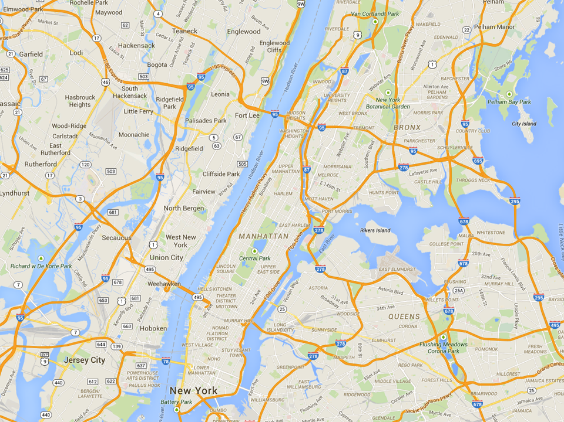
Most Common MTO Residential Locations in New York
Experimental
Wakefield Bronx
Section 8
Soundview Bronx
Control
King Towers
Harlem

Slide 30
Impacts of MTO on Children Below Age 13 at Random Assignment
(a) Individual Earnings (ITT)
(b) Individual Earnings (TOT)
17000
17000
15000
15000
13000
13000
Individual Income at Age ≥ 24 ($)
Individual Income at Age ≥ 24 ($)
11000
11000
9000
9000
$11,270
$12,380
$12,894
$11,270
$12,994
$14,747
7000
p = 0.101
p = 0.014
7000
p = 0.101
p = 0.014
5000
5000
Control
Section 8
Experimental
Voucher
Control
Section 8
Experimental
Voucher

Slide 31
Impacts of MTO on Children Below Age 13 at Random Assignment
(a) College Attendance (ITT)
(b) College Quality (ITT)
22000
20
21000
15
College Attendance, Ages 18-20 (%)
Mean College Quality, Ages 18-20 ($)
20000
10
5
16.5%
17.5%
19.0%
19000
$20,915
$21,547
$21,601
p = 0.435
p = 0.028
p = 0.014
p = 0.003
0
18000
Control
Section 8
Experimental
Voucher
Control
Section 8
Experimental
Voucher

Slide 32
Impacts of MTO on Children Age 13-18 at Random Assignment
(a) Individual Earnings (ITT)
(b) Individual Earnings (TOT)
17000
17000
15000
15000
13000
13000
Individual Income at Age ≥ 24 ($)
Individual Income at Age ≥ 24 ($)
11000
11000
9000
9000
$15,882
$14,749
$14,915
$15,882
$13,830
$13,455
7000
p = 0.219
p = 0.259
7000
p = 0.219
p = 0.259
5000
5000
Control
Section 8
Experimental
Voucher
Control
Section 8
Experimental
Voucher

Slide 33
Policy Approach 2: Improving Neighborhoods
Limits to scalability of policies that move people
  Also need policies that improve existing neighborhoods
Challenging to identify causal effects of local policies
  As a first step, characterize the features of areas that generate good outcomes

Slide 34
Strongest Correlates of Causal Exposure Effects at the CZ Level
For Children with Parents at 25th Percentile of Income Distribution
Correlation
Fraction
Black
Residents
-0.51
Racial
Segregation
-0.51
Gini
Coef.
-0.76
Fraction
Single
Moms
-0.57
Social
Capital
0.70
Student-
Teacher
Ratio
-0.34
-2.5
-2.0
-1.5
-1.0
-0.5
0
0.5
1.0
1.5
2.0
2.5
Effect of 1 SD Increase in Covariate on Child’s Expected Rank

Slide 35
Opportunities for Upward Mobility and Economic Growth
Interest in greater social mobility is traditionally based on principles of justice
But improving opportunities for upward mobility could also increase productivity and growth
To illustrate, focus on innovation
  Study the lives of 750,000 patent holders in the U.S. by linking universe of patent records to tax records
Source: Bell, Chetty, Jaravel, Petkova, van Reenen 2015

Slide 36
Probability of Patenting by Age 30 vs. Parent Income Percentile
8
Patent rate for children
with parents in top 1%:
8.3 per 1,000
6
4
No. of Inventors per Thousand Children
2
Patent rate for children
with parents below median:
0.85 per 1,000
0
0
20
40
60
80
100
Parent Household Income Percentile
Notes: Sample of children is 1980-82 birth cohorts. Parent Income is mean from 1996-2000.

Slide 37
Patent Rates vs. 3rd Grade Math Test Scores in NYC Public Schools
5
90th Percentile
4
3
No. of Inventors per Thousand Children
2
1
0
-2
-1
0
1
2
3rd Grade Math Test Score (Standard Deviations Relative to Mean)
Notes:
Fig4
Top 5%: 4.99 Inventors per Thousand
Below p80: 0.41 Inventors per Thousand
Below Median: 0.34 Inventors per Thousand

Slide 38
Patent Rates vs. 3rd Grade Math Test Scores
for Children with Low vs. High Income Parents
8
6
4
No. of Inventors per Thousand Children
2
0
-2
-1
0
1
2
3rd Grade Math Test Score (Standard Deviations Relative to Mean)
Par. Inc. Below 80th Percentile
Par. Inc. Above 80th Percentile
Notes:
Fig7

Slide 39
Patent Rates vs. 3rd Grade Math Test Scores
for Children with Low vs. High Income Parents
8
6
High-scoring children more likely to become inventors if they are from high-income families
4
No. of Inventors per Thousand Children
2
0
-2
-1
0
1
2
3rd Grade Math Test Score (Standard Deviations Relative to Mean)
Par. Inc. Below 80th Percentile
Par. Inc. Above 80th Percentile
Notes:
Fig7
Top 5%, Income Above p80: 6.76 Inventors per Thousand
Top 5%, Income Below p80: 3.08 Inventors per Thousand

Slide 40
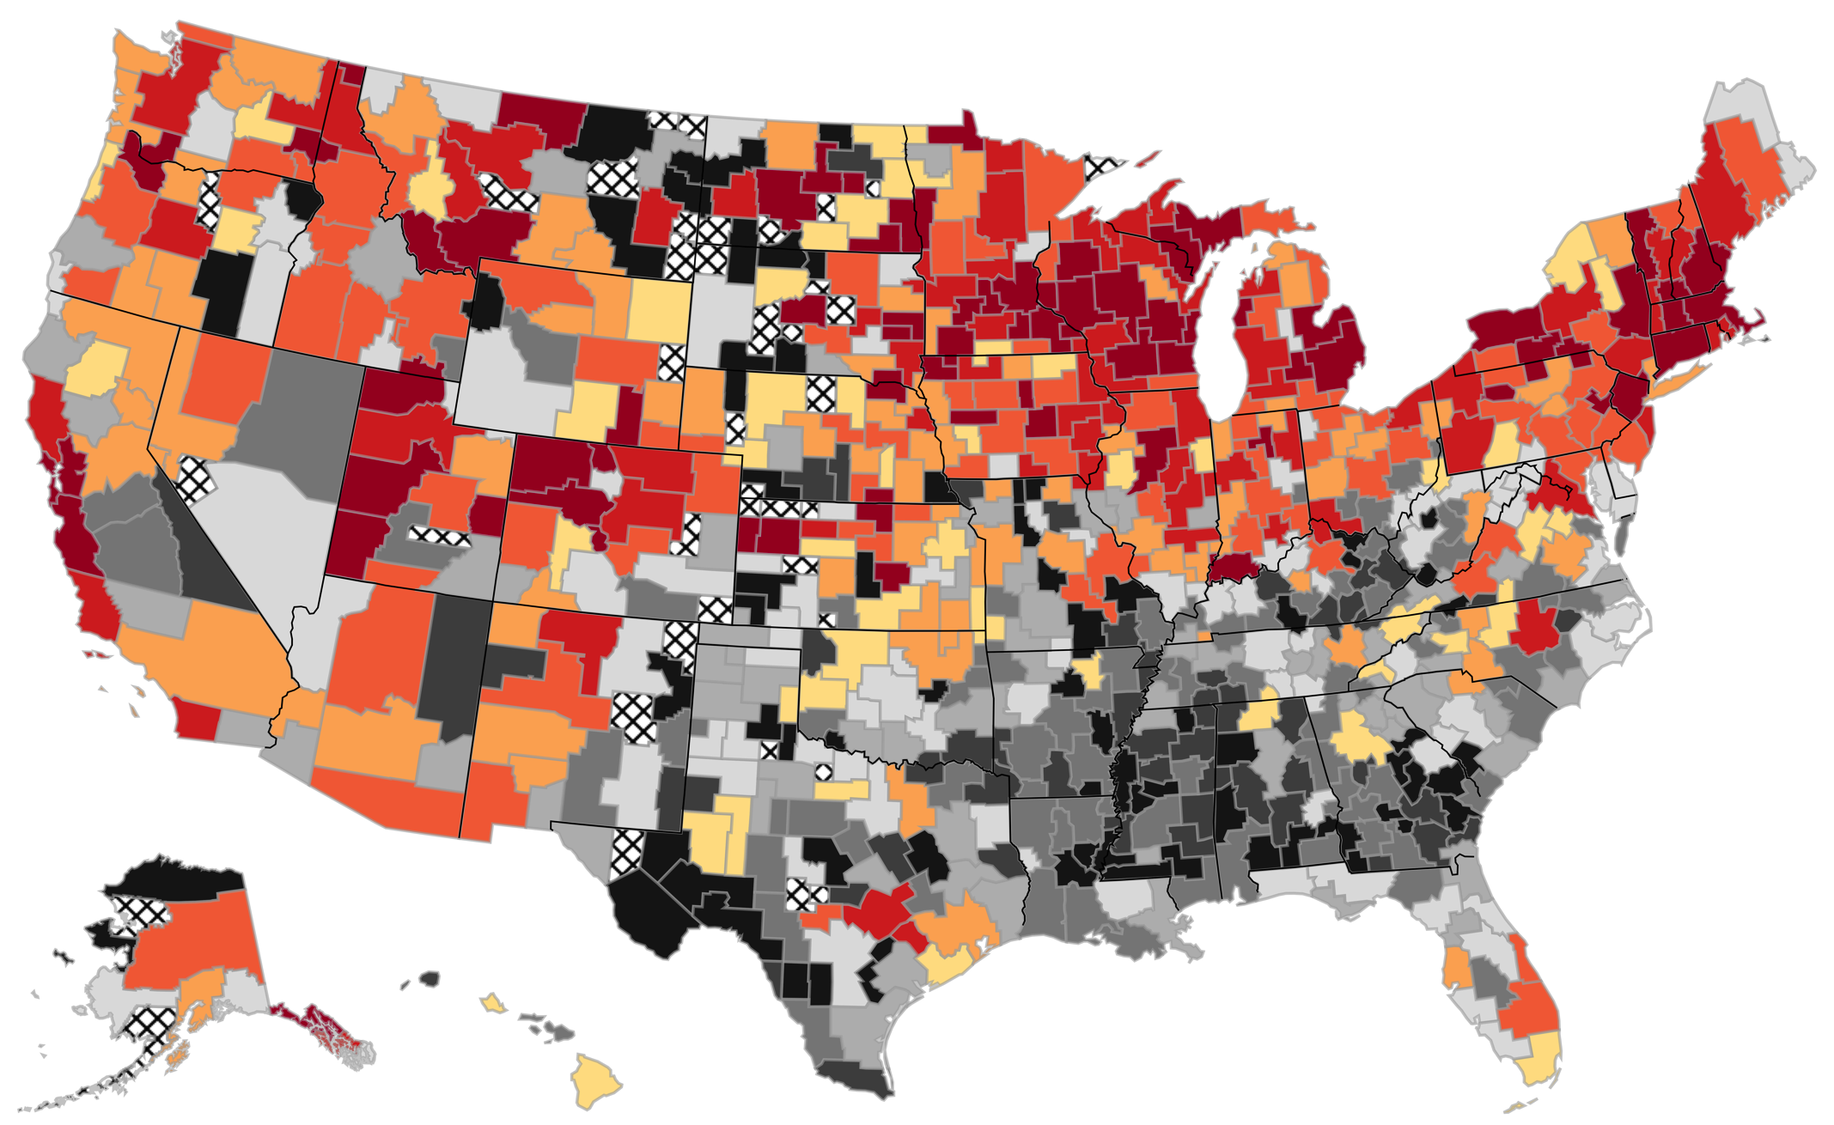
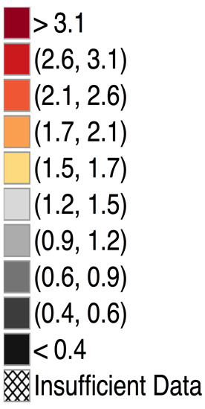
The Origins of Inventors
Patent Rates per 1000 Children by CZ where Child Grew Up

Slide 41
Patent Technology Classes
Category: Computers + Communications
Subcategory: Communications
Technology Class
Pulse or digital communications
Demodulators
Modulators
Coded data generation or conversion
Electrical computers: arithmetic processing and calculating
Oscillators
Multiplex communications
Telecommunications
Amplifiers
Motion video signal processing for recording or reproducing
Directive radio wave systems and devices (e.g., radar, radio navigation)
Notes:
41
Pulse or digital communications (375)
Demodulators (329)
Modulators (332)

Slide 42
Neighborhoods and Economic Opportunity: Future Agenda
Key question going forward: How can we improve neighborhood environments for disadvantaged youth?
We are pursuing both policy approaches discussed earlier
  Help families move to better neighborhoods
  [with Stefanie Deluca, Nathan Hendren, Larry Katz, and Christopher Palmer]
    Partnership with HUD and 15 large public housing authorities
    Developing experimental interventions on supply and demand side of voucher market to create moves to opportunity

Slide 43
Neighborhoods and Economic Opportunity: Future Agenda
Key question going forward: How can we improve neighborhood environments for disadvantaged youth?
We are pursuing both policy approaches discussed earlier
  Improve neighborhoods with low levels of upward mobility
    Constructing mobility statistics at census tract level and conducting ethnographic studies of outliers
    Neighborhoods as networks: do friendship networks in SF cross socioeconomic boundaries more than those in Atlanta?
    [with Matthew Jackson]

Slide 44
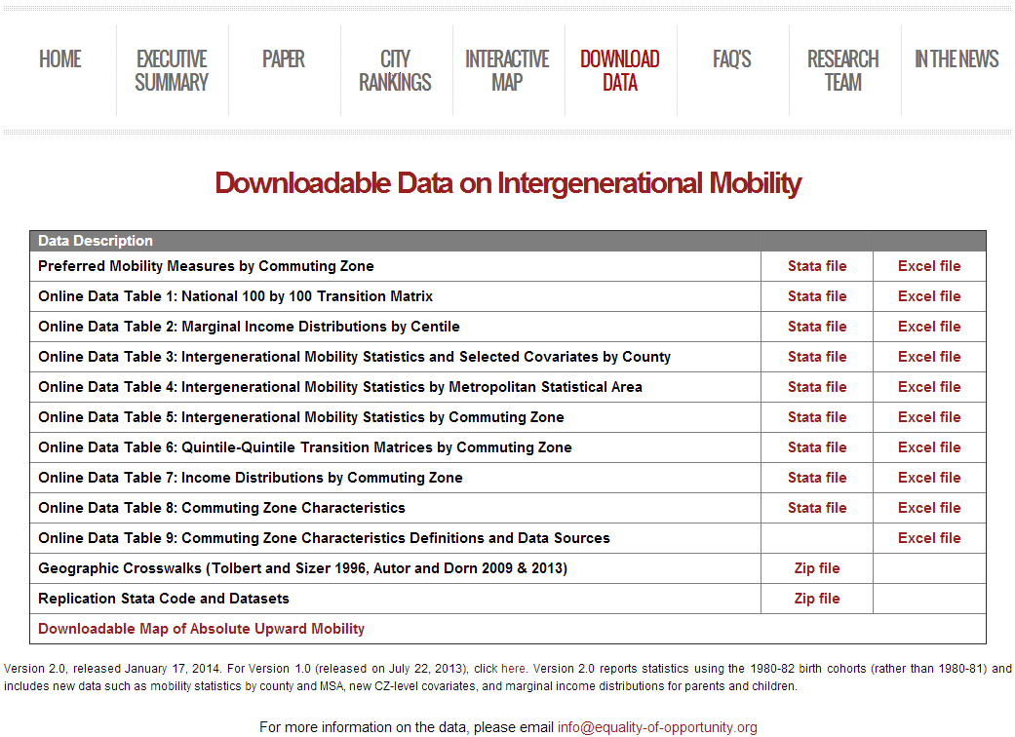
Download County-Level Data on Intergenerational Mobility in the U.S.
www.equality-of-opportunity.org/data

